Slide 1
Frontend for end-users
Jeroen Claassens
Notes:
Good morning everyone. In the workshop today I will introduce you to the world of frontend development.

Slide 2
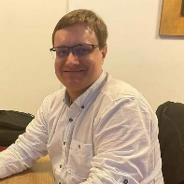
Who am I
Jeroen Claassens | Experienced Software Engineer +31 (0)6 5112 7382
j.claassens@cgi.com
Notes:
First a bit about myself. Hi! My name is Jeroen Claassens. I’ve been a developer for about 10 years now

Slide 3
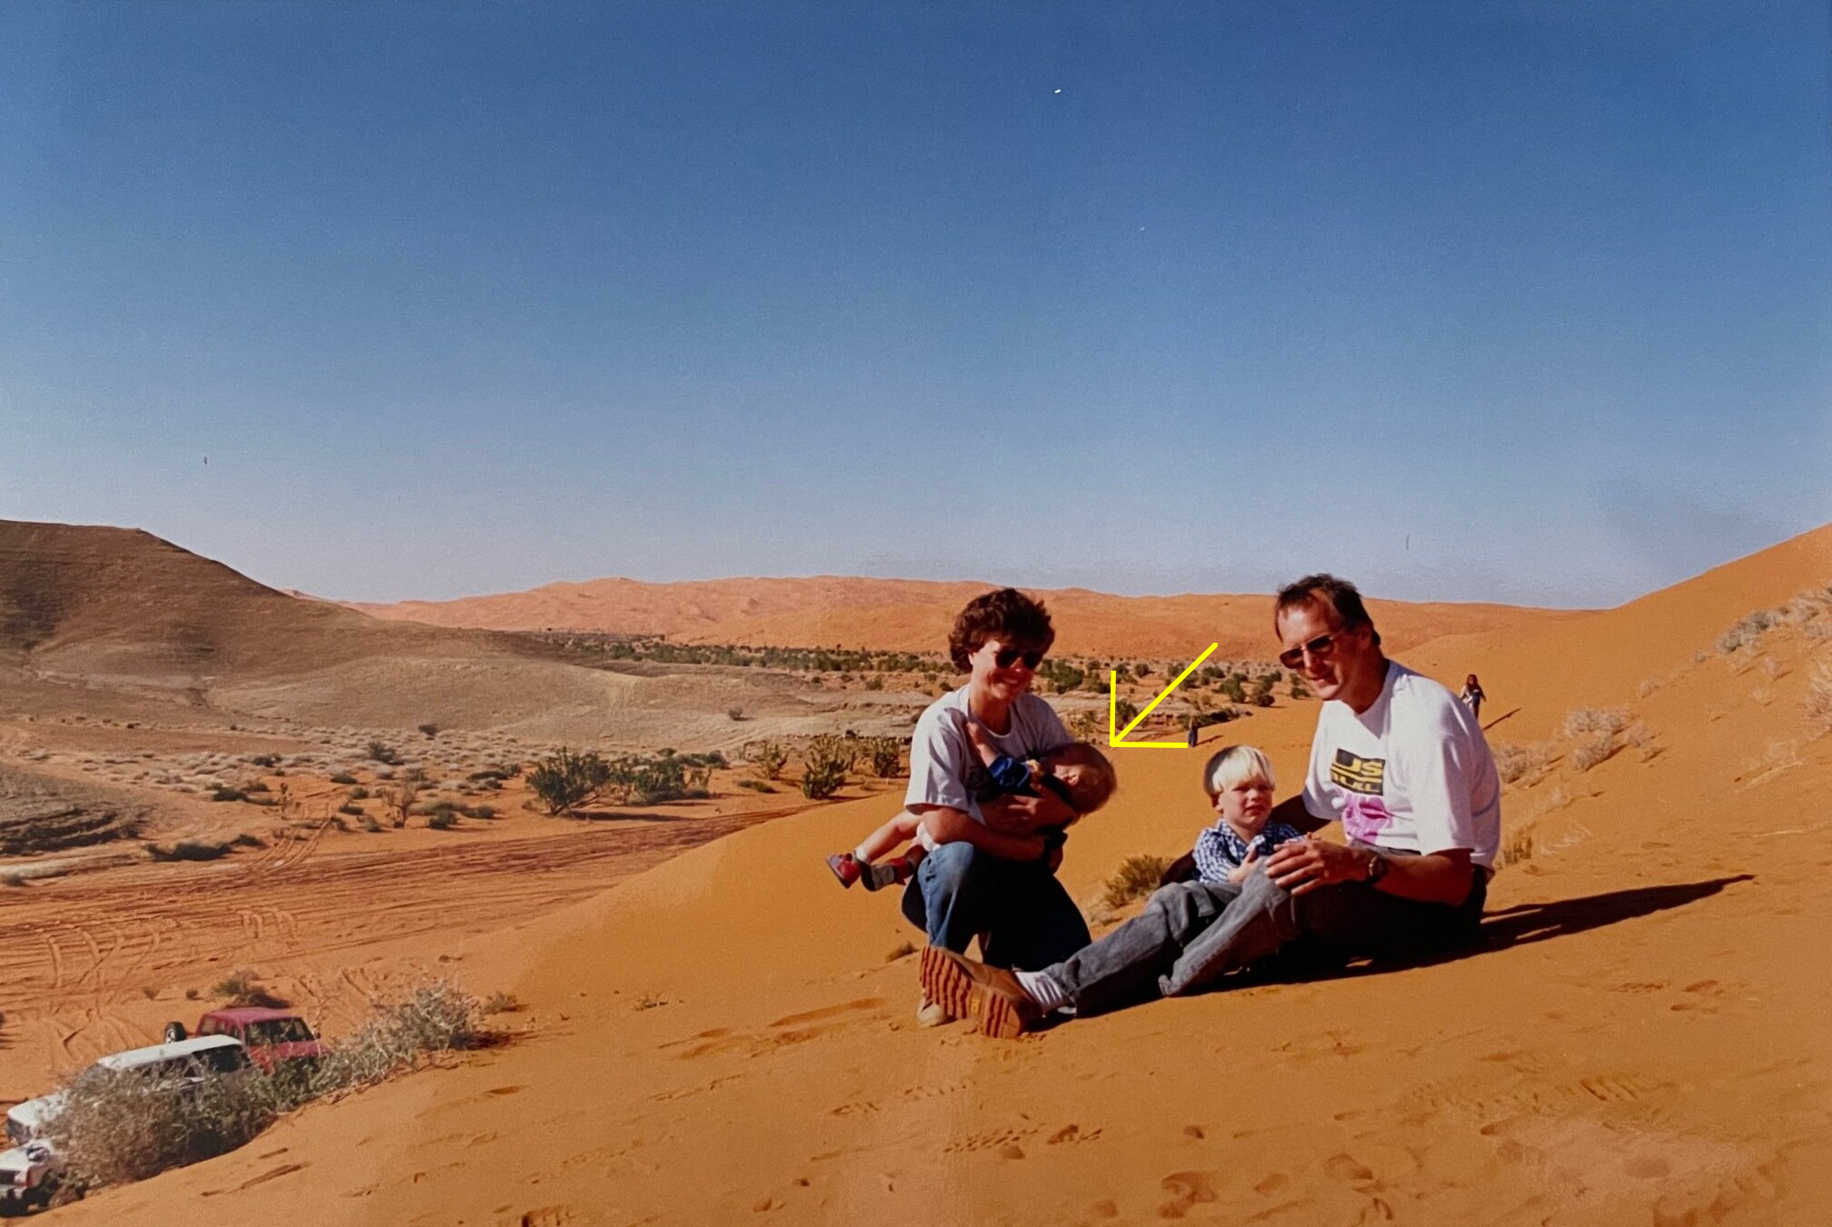
Who am I?
I Live in Delft
I’m a huge fantasy nerd (talk to me about Lord of The Rings, Harry Potter, Dungeons & Dragons, and more)
I do a lot of open source development in my free time.
I love building PCs and working with tech.
Notes:
I was born in the deserts of Saudi Arabia

Slide 4
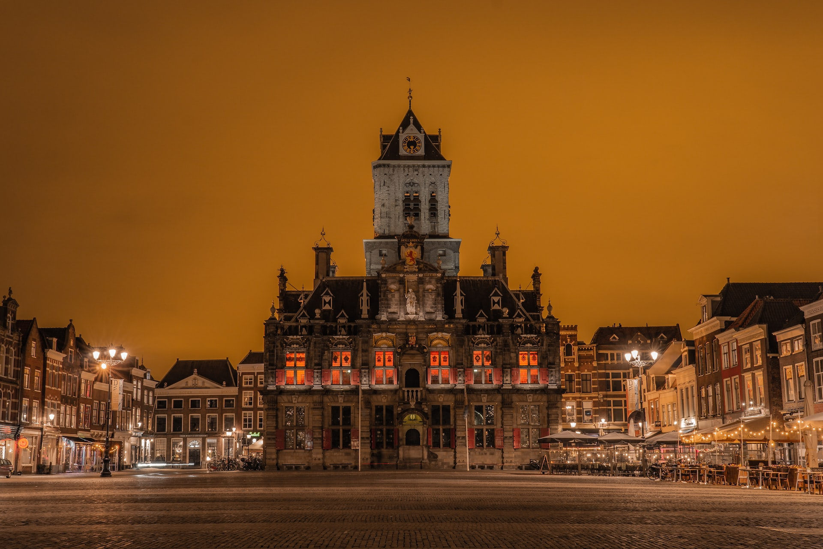
Who am I?
I Live in Delft
I’m a huge fantasy nerd (talk to me about Lord of The Rings, Harry Potter, Dungeons & Dragons, and more)
I do a lot of open source development in my free time.
I love building PCs and working with tech.
Notes:
but right now I live in the beautiful city of Delft

Slide 5
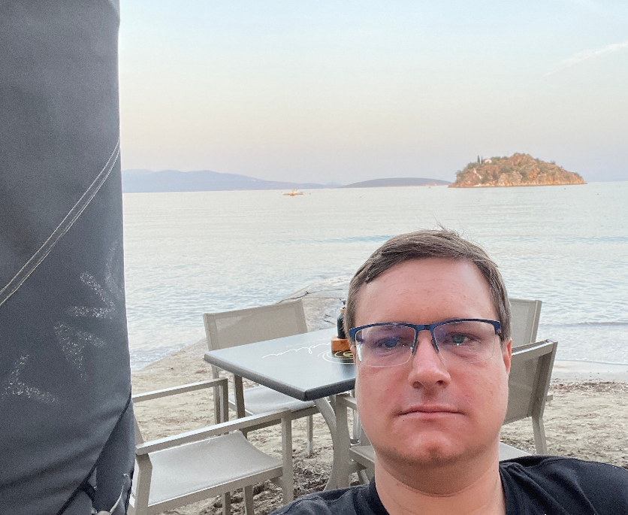
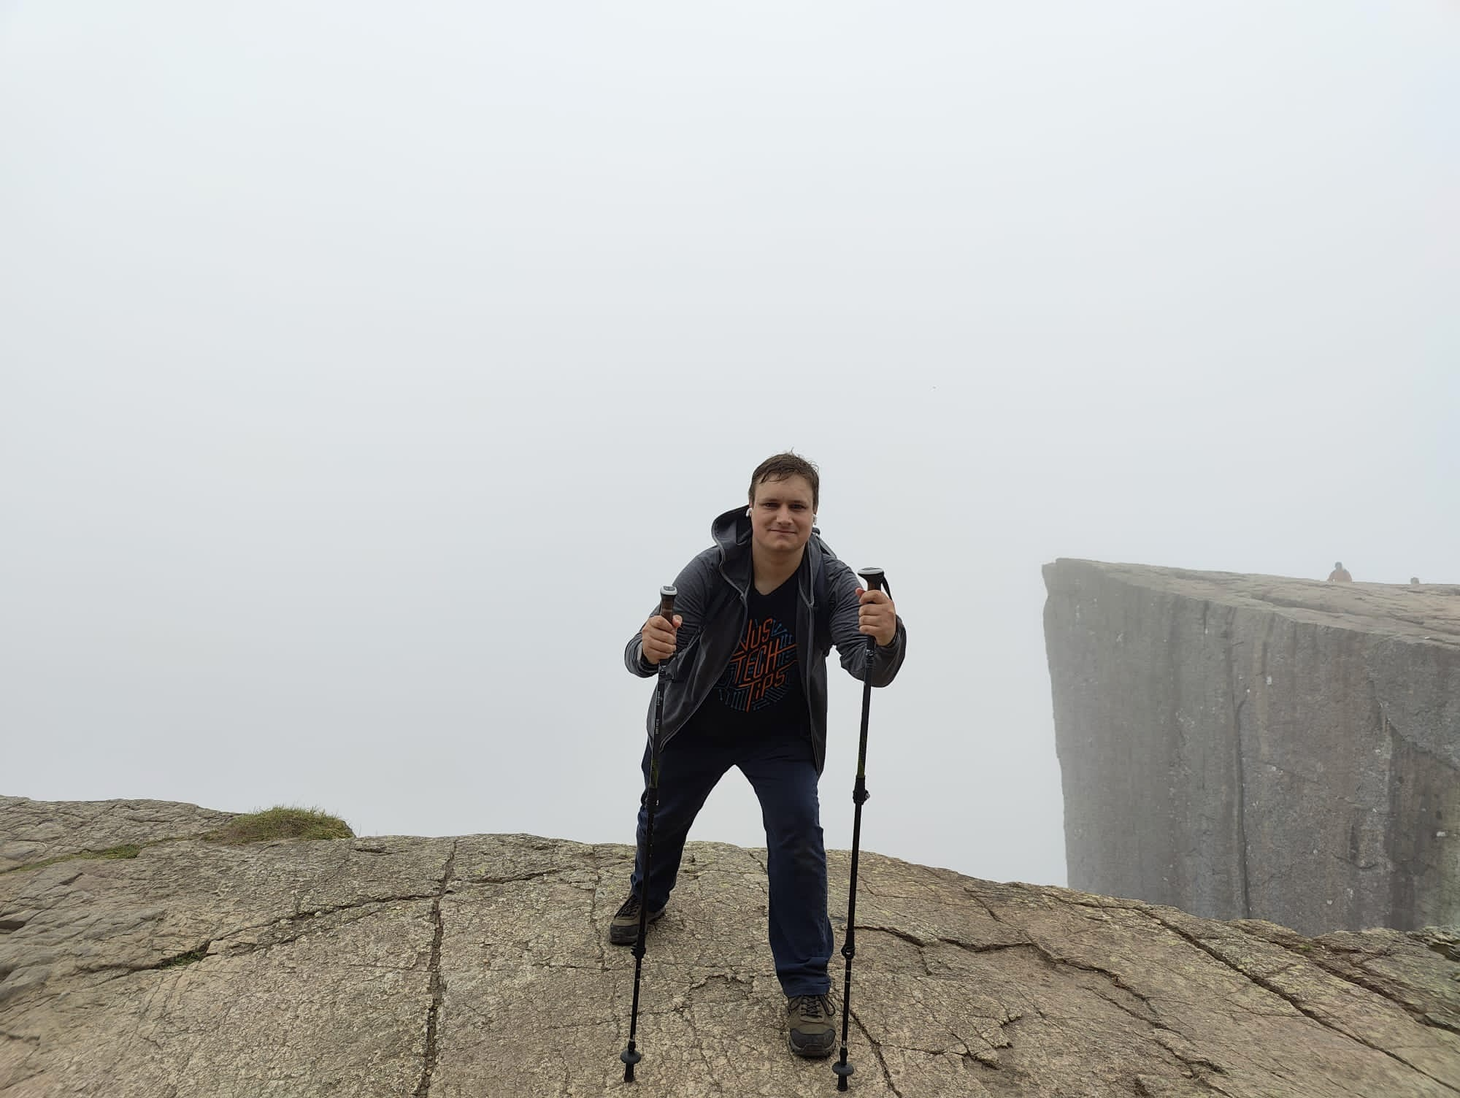
Who am I?
I’m a huge fantasy nerd (talk to me about Lord of The Rings, Harry Potter, Dungeons & Dragons, and more)
My free time is primarily spent with open source development and (table-top) gaming.
I love learning about and working with all tech.
Notes:
In my spare time I’m a huge lover of all kinds of fantasy. My free time I primarily spent workin on various open source projects that I maintain and I also game a lot. In general I am also a big fan of all things tech.

Slide 6


Who am I?
Jeroen Claassens (Experienced Software Engineer)
Started at CGI in March 2019
Rijkswaterstaat (1,5 years)
Full-stack TypeScript & Java developer
Primarily worked the new Asset Management frontend
ProRail (2,5 years)
Full-stack TypeScript & Java developer
Worked on improving the front- and backend of the GMS/WLIS project
Back at Rijkswaterstaat (current)
Java developer & ops engineer
Back on the project of 2019, of which the landscape has greatly changed
Notes:
I started working for CGI in 2019. First I worked for the Rijkswaterstaat unit where I was primarily a frontend development but also dabbled a bit in the Backend, CI/CD, Cloud and Ops processes of the project. After this I moved to the ProRail unit where I worked as a full-stack frontend and backend developer, and right now I have moved back to Rijkswaterstaat and I am now working on the same project where I started at 2019 but primarily as a backend developer while also doing ops.

Slide 7
General workshop information
The workshop will have both and morning and afternoon program
I encourage the taking of notes, because we will go through a lot of information
These slides will be sent to all participants after the course. The slide notes have a rough outline of what I have told you.
Notes:
First I would like to address some general notes for today. Today we will have both a morning and an afternoon program. Furthermore this is the first time that we are including a frontend fundamentals workshop in the graduate class, so in advance I’m apologize for any mistakes haha. Because of this I can also not say entirely for sure at what time we will be finished, but at the latest we will stop at 4 30.
Next I encourage the taking of notes. We will go through a lot of information and there will be a lot of information to process. Notes can help you do so.
Lastly these slides will be sent to all participants after the course. I have included the bulk of what I will tell you in the speaker notes of each slide so you can review most of the workshops.

Slide 8
Has everyone managed to install NodeJS?
Notes:
Before we start I would like to check if everyone was able to complete their homework, installing NodeJS.
For those that have faced issued, I have reserved a about 10 minutes before the lunch to aid you.

Slide 9
Agenda
Introduction
A brief introduction to frontend and its importance
HTML / CSS / JavaScript
Lunch 🥪🍽️
Frontend development in the field
Notes:
Now lets go over the agenda for today. First of all I will quickly introduce myself. Next I will give you a brief introduction to what frontend is, how we define frontend for the scope of this workshop, and why frontend should be considered as an important part of the services delivered by CGI. After this I will give you an introduction to HTML, CSS, and JavaScript which together make up the fundamental building blocks for developing a modern frontend. This should take until about a quarter to twelve after which there will be some time to help anyone who wasn’t able to complete their homework or time for longer questions and then we’ll have lunch until 1 o clock. After the lunch we’ll dive into the frontend development as you might see it being used in the field at CGI projects, this means we’ll start working with Node, looking into libraries like React, and more.

Slide 10
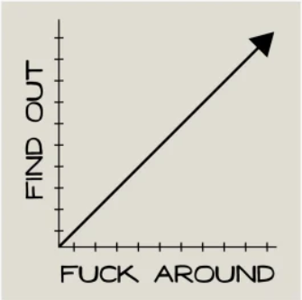
My vision on this course

Slide 11
What does an application need in order to be able to run?
Notes:
Brendan:

Slide 12
What does an application need in order to be able to run?
Runtime (e.g. JVM or .NET runtime)
Notes:
Platform om applicaties te runnen, bouwen en te shippen. Dit platform voorziet dus van alle benodigdheden om een applicatie te kunnen runnen.

Slide 13
How do we provide runtime for an application?
Notes:
Brendan

Slide 14
How do we provide runtime for an application?
Pc or laptop
Virtual Machine
Notes:
Typische productie/enterprise omgeving: VM’s. Wie weet wat een VM is?

Slide 15
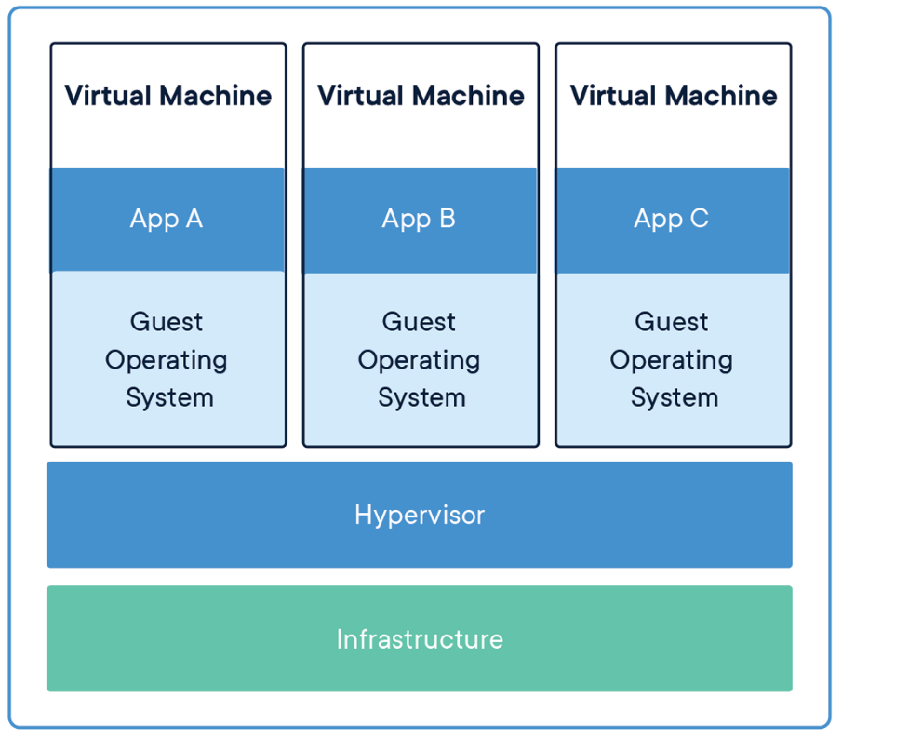
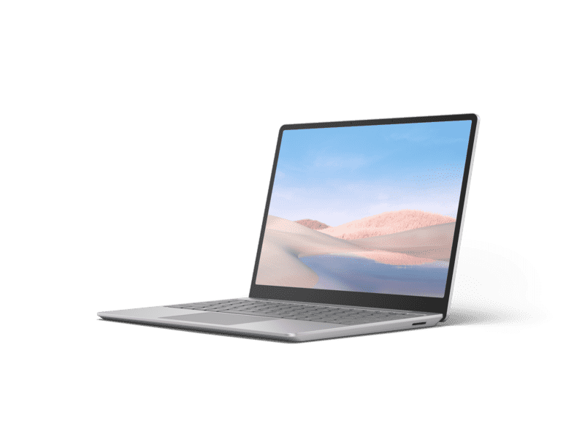
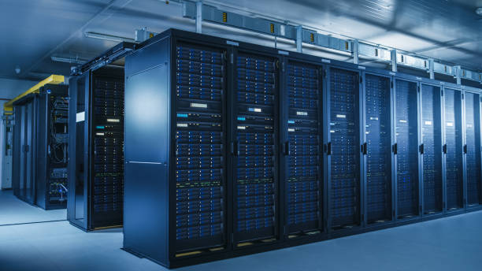
What is a VM?
Emulation of a computer
Contains:
Operating system
Networking
Memory & Storage
Etc.
Notes:
Typische productie/enterprise omgeving: VM’s. Wie weet wat een VM is?

Slide 16
Drawbacks of VM’s
Requires lots of configuration
Network
Storage & Memory etc.
Requires lots of resources
Each VM it’s own OS.
Requires maintenance
Updates etc.
SOLUTION: CONTAINERIZATION
Notes:
Typische productie/enterprise omgeving: VM’s. Wie weet wat een VM is?

Slide 17
What is Podman?
Notes:
Jeroen

Slide 18


Docker vs Podman
What is the difference?
Why do we use Podman in this course?
What about after the graduate class?
Notes:
Jeroen
The first thing we want to address is Podman and Docker and their similarities and differences. By now you should have all installed Podman as per our installation instructions, but you may have also heard about Docker in the context of containerzation and you may be wondering why we didn’t just ask you guys to install Docker.
Podman and Docker are both applications that offer a containerization engine. Their commands for managing that engine are also (nearly) all identical. The difference really comes down to the following factors
1. Who creates the application, in Docker’s case that’s the Docker ogranization and for Podman that’s Red Hat
2. Licensing. Docker Desktop, that is the GUI application that runs on Windows and Mac, requires a paid license when used in an enterprise setting like we are here. While many CGI projects for our clients will have licenses available for the developers and those licenses refresh on a yearly basis, it is not feasible to offer licenses for the graduate class as Docker was not able to give us transferrable licenses that would be valid for a period of roughly 2 per months every time. Podman Desktop however is completely free and doesn’t have these issues. Primarily for this reason we have decided to give this workshop with Podman.
As I mentioned just before, many projects for CGI clients do offer Docker licenses. At the same time, there are also projects that use Podman. This means that what you will actually end up using (if anything) will depend heavily on where you will land. You may need to eventually uninstall Podman and install Docker, but with the knowledge that we hope to impart today you should have a good foundation for both applications.

Slide 19

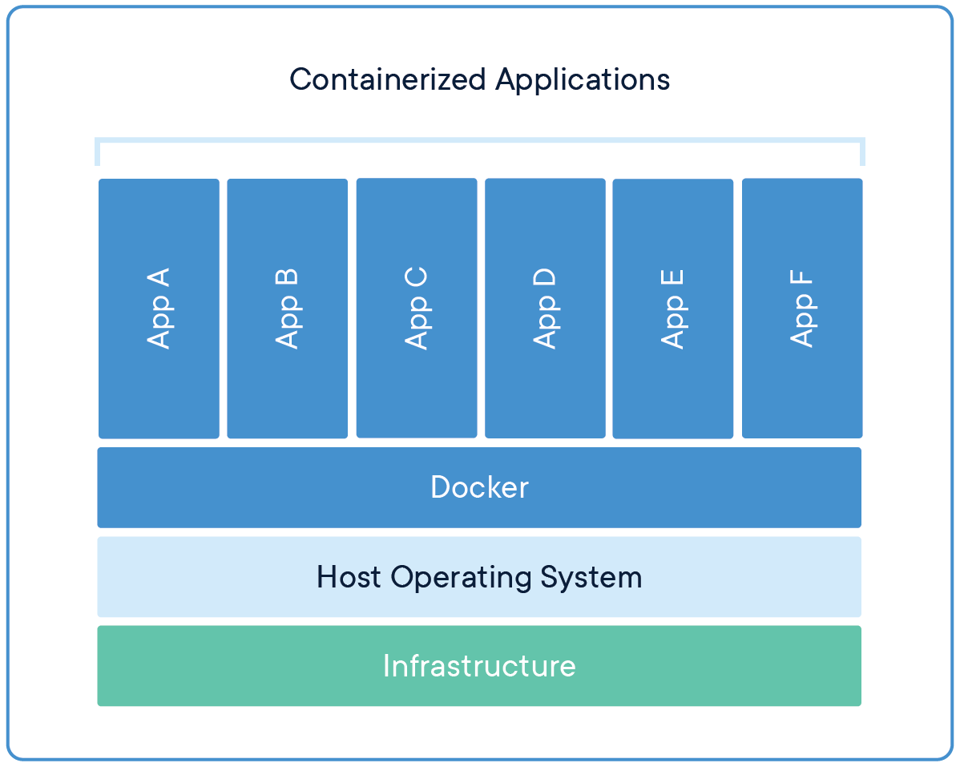
What is Podman?
A platform for building, running and shipping applications.
With podman you can create executable packages, with ONLY the required runtime and other dependencies. The Podman engine uses the host OS to run the ‘containerized’ applications, so only 1 OS is required.
Notes:
Platform om applicaties te runnen, bouwen en te shippen. Dit platform voorziet dus van alle benodigdheden om een applicatie te kunnen runnen.

Slide 20
What is a Container?
A standardized, running unit of software
Image: An executable package that contains everything needed to run the application (a blueprint, or recipe)
Container: A running instance of an image.
In OOP terms: An image is a class, and a container is the instantiation of that class.
Notes:
Platform om applicaties te runnen, bouwen en te shippen. Dit platform voorziet dus van alle benodigdheden om een applicatie te kunnen runnen.

Slide 21
Exercise 1: Hello world image.
Check Docker Hub:
podman pull hello-world
podman image ls
podman run hello-world
Notes:
Deelnemers:

Slide 22
Demonstration: Create your own Hello world.
Notes:
Brendan: Java

Slide 23
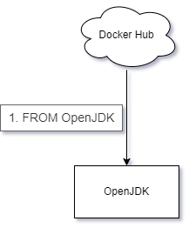
What did we just do?

Slide 24
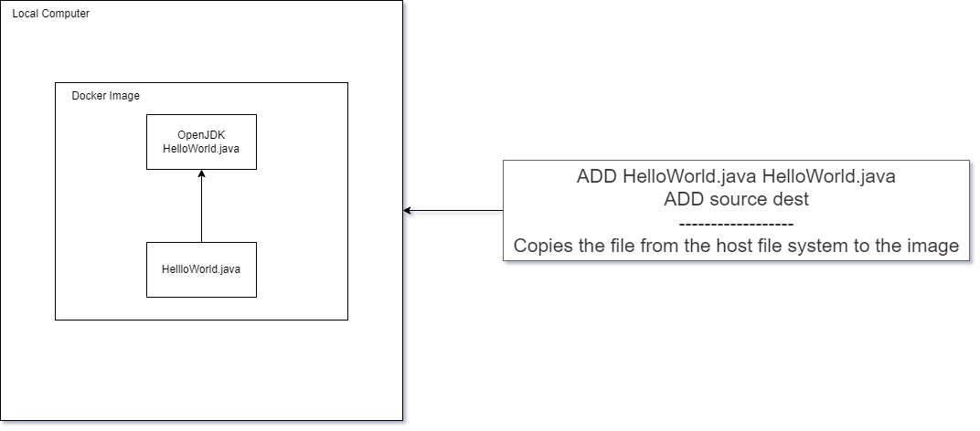
What did we just do?

Slide 25
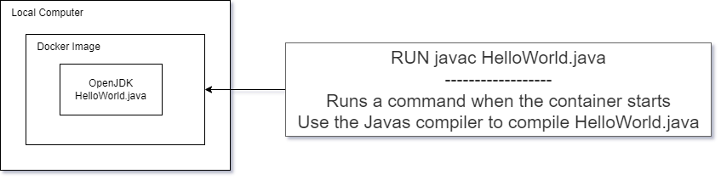
What did we just do?

Slide 26
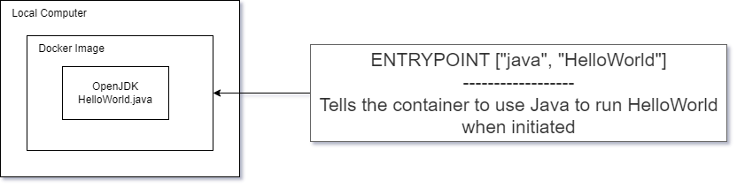
What did we just do?

Slide 27
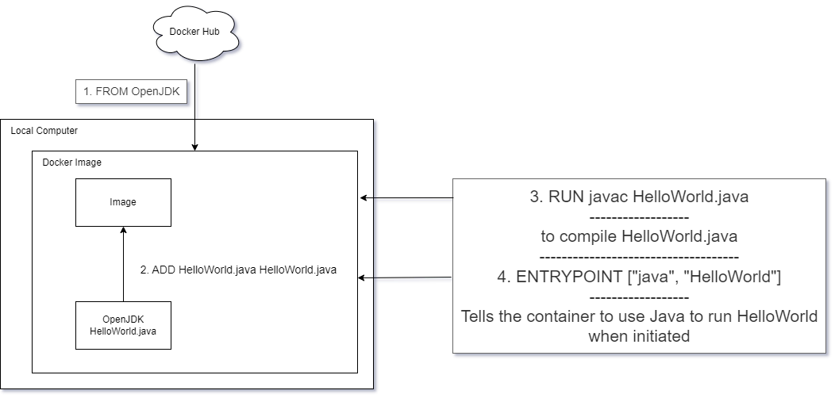
What did we just do?

Slide 28
Exercise: Create your own Hello world container.
Step 1: Create 1 simple java program.
Step 2: Find base image. (with correct requirements e.g. JDK)
Step 3: Create Dockerfile.
Step 4: build and run container.

Slide 29
Creating a Podman container
Find base image, create dockerfile, and commands to run

Slide 30
Exercise: Create your own hello world.
Notes:
Deelnemers:

Slide 31
What is scalability?
Notes:
Brendan

Slide 32
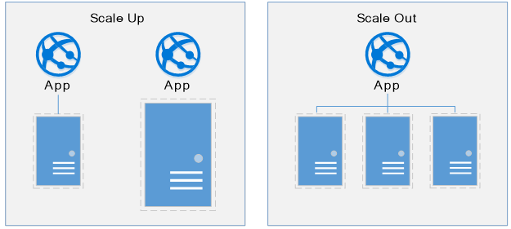
What is Scalability?

Slide 33
Exercise 2: Scaling your hello world program.
Notes:
Deelnemers:

Slide 34
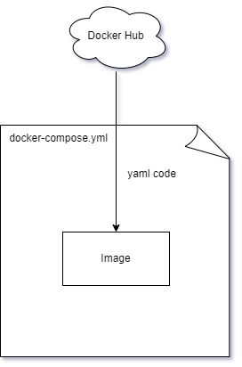
What the exercise achieved
Notes:
We used a podman compose file to have a scripted version of all the various docker commands we had to run manually before
Using a docker compose file we can have an easier time reproducing between systems without risking making copy paste mistakes.

Slide 35
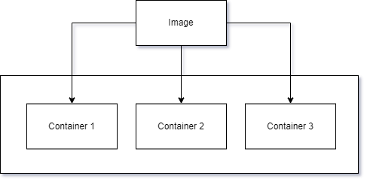
What the exercise achieved
Notes:
The docker image we build was spawned into 3 separate instances of the container

Slide 36
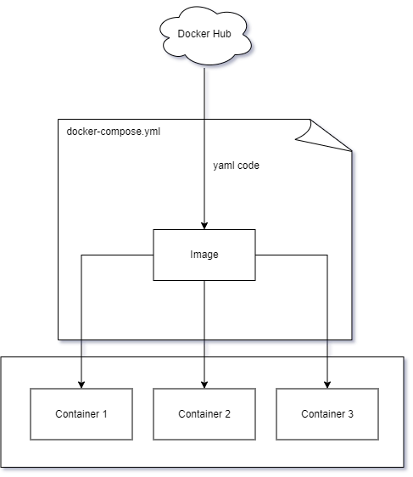
What the exercise achieved
Notes:
Putting it all together

Slide 37
What is a loadbalancer?
Notes:
Brendan

Slide 38
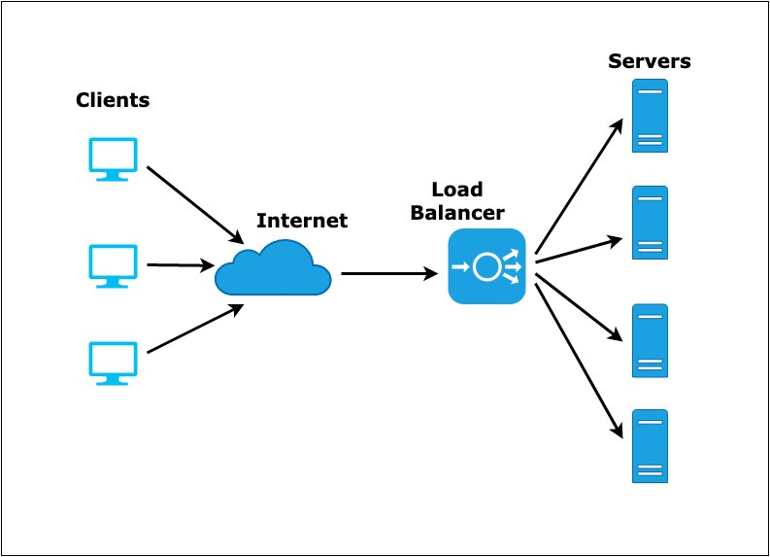
What is a loadbalancer?

Slide 39
Exercise 3: Loadbalancers.
Notes:
Deelnemers:

